Slide 1
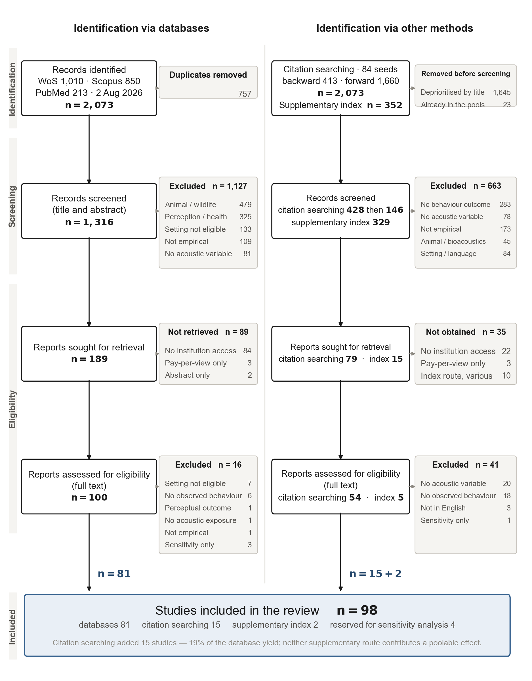
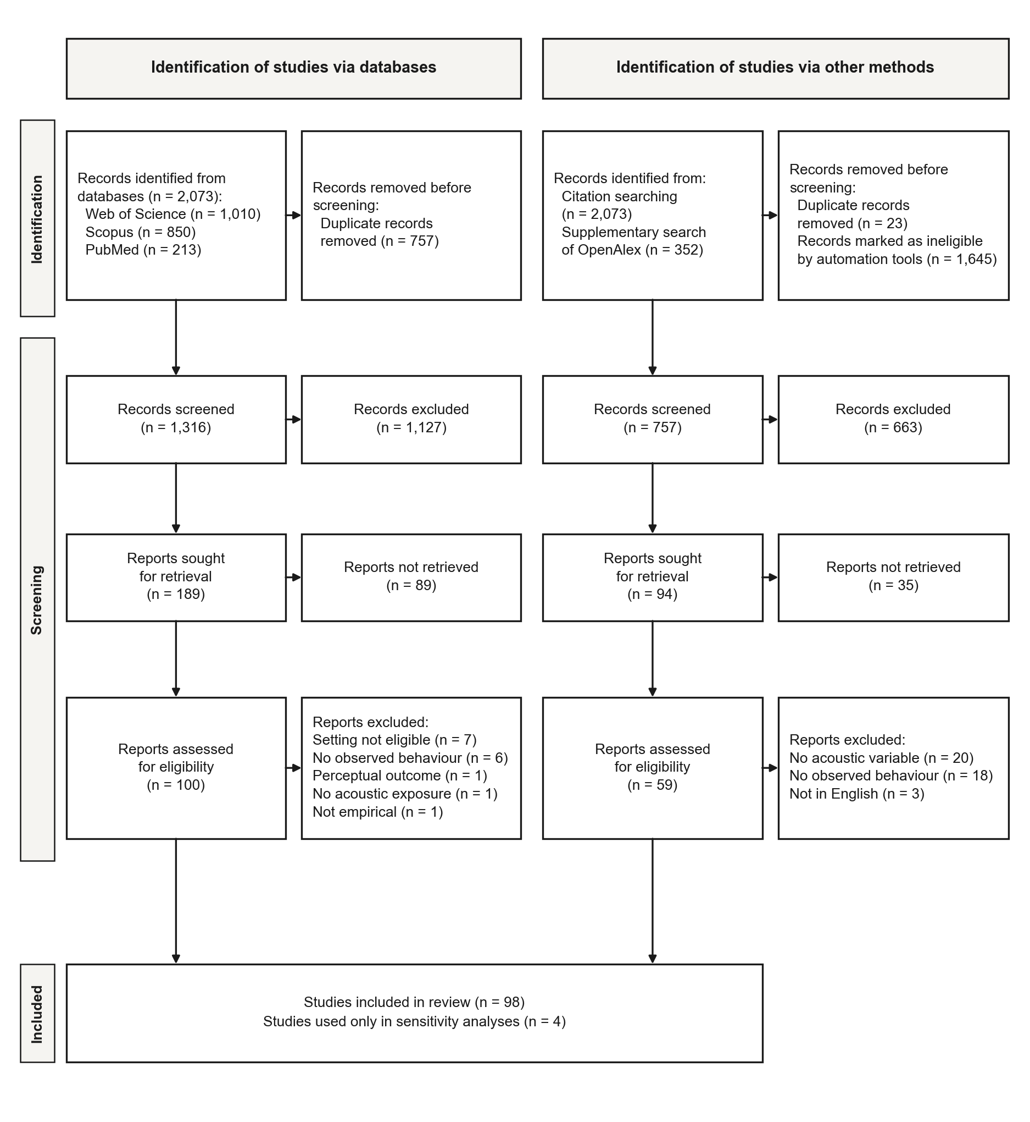
Identification of studies via databases
Identification of studies via other methods
Records identified from databases:
Web of Science (n = 1,010)
Scopus (n = 850)
PubMed (n = 213)
n = 2,073
Removed before screening
Duplicate records (n = 757)
n = 757
Records identified from:
Citation searching (n = 2,073)
Supplementary search of OpenAlex (n = 352)
n = 2,425
Removed before screening
Duplicate records (n = 23)
Records marked as ineligible by automation tools (n = 1,645)
n = 1,668
Identification
Records screened
n = 1,316
Records excluded
n = 1,127
Records screened
n = 757
Records excluded
n = 663
Reports sought for retrieval
n = 189
Reports not retrieved
n = 89
Reports sought for retrieval
n = 94
Reports not retrieved
n = 35
Screening
Reports assessed for eligibility
n = 100
Reports excluded
Setting not eligible (n = 7)
No observed behaviour (n = 6)
Perceptual outcome (n = 1)
No acoustic exposure (n = 1)
Not empirical (n = 1)
n = 16
Reports assessed for eligibility
n = 59
Reports excluded
No acoustic variable (n = 20)
No observed behaviour (n = 18)
Not in English (n = 3)
n = 41
Studies included in review (n = 98)
Studies used only in sensitivity analyses (n = 4)
Included

Slide 2
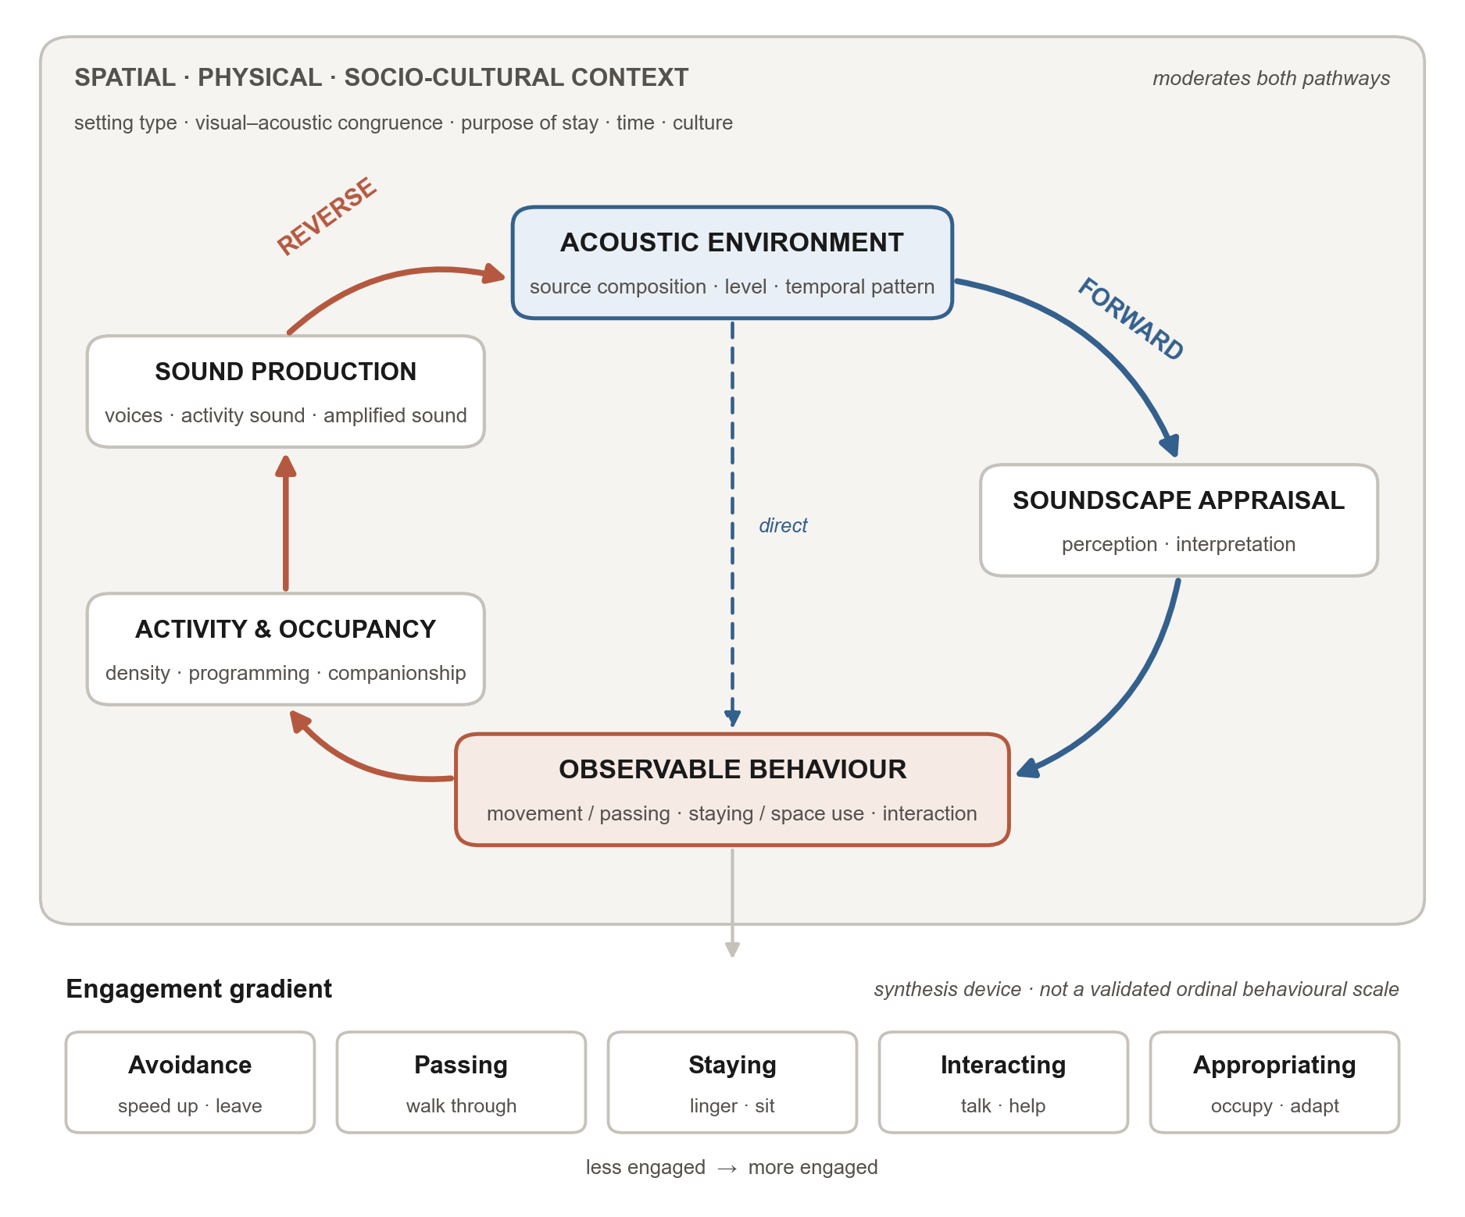
Identification
SPATIAL  PHYSICAL  SOCIO-CULTURAL CONTEXT
Setting type  visual–acoustic congruence  purpose of stay  time  culture
Moderates both pathways
REVERSE
ACOUSTIC ENVIRONMENT
Source composition  Level  Temporal pattern
FORWARD
SOUND PRODUCTION
Voices  Activity sound  Amplified sound
SOUNDSCAPE APPRAISAL
Perception  Interpretation
Direct
ACTIVITY & OCCUPANCY
Density  Programming  Companionship
OBSERVABLE BEHAVIOUR
Movement / Passing  Staying / Space use  Interaction
Engagement gradient
Synthesis device  not a validated behavioural scale
Avoidance
Speed up  Leave
Passing
Walk through
Staying
Linger  Sit
Interacting
Talk  Help
Appropriating
Occupy  Adapt
Less engaged
More engaged

